Slide 1

STAT 641
Statistical Data Analytics Case Study
Monthly Extent of North Pole Sea Ice Flow
from 1979 to 2017
Group 3: Mengxi Lv, Michela Gao, Rujia Wei
Advisor: Thomas W. Ilvento
Statistics Program
University of Delaware
Notes:
Thank you for the introduction. My topic is…

Slide 2
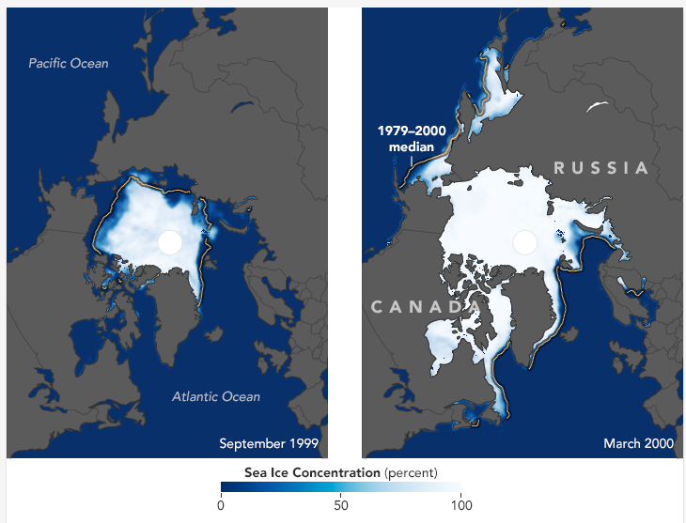

Arctic Sea Ice
Aim : to analyze whether there is evidence of shrinkage of north sea ice over time
Notes:
The disease we focus on is osteoarthritis. The left picture is a healthy human knee joint. The right one is a human knee with osteoarthritis with cartilage degeneration. In contrast, healthy joint has a layer of cartilage. It is white, shining and smooth.

Slide 3
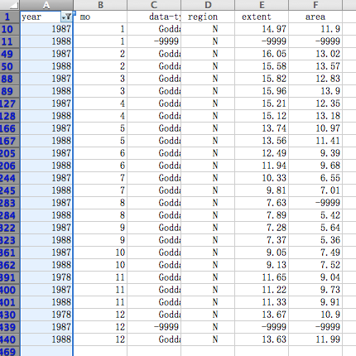
About the data
combined provided data
eliminate extraneous data
fill in missing data
Notes:
The disease we focus on is osteoarthritis. The left picture is a healthy human knee joint. The right one is a human knee with osteoarthritis with cartilage degeneration. In contrast, healthy joint has a layer of cartilage. It is white, shining and smooth.

Slide 4

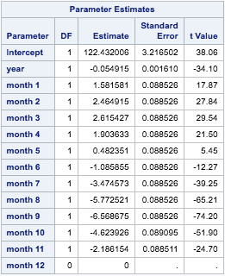
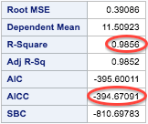
Regression Model:
extent = b1*year + b2*month + b0
Notes:
The disease we focus on is osteoarthritis. The left picture is a healthy human knee joint. The right one is a human knee with osteoarthritis with cartilage degeneration. In contrast, healthy joint has a layer of cartilage. It is white, shining and smooth.

Slide 5
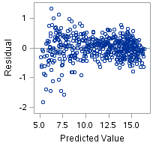
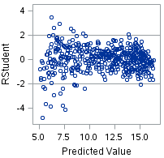
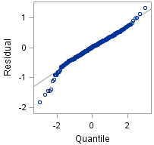
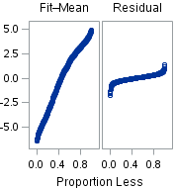
Regression Model:
extent = b1*year + b2*month + b0
Notes:
The disease we focus on is osteoarthritis. The left picture is a healthy human knee joint. The right one is a human knee with osteoarthritis with cartilage degeneration. In contrast, healthy joint has a layer of cartilage. It is white, shining and smooth.

Slide 6
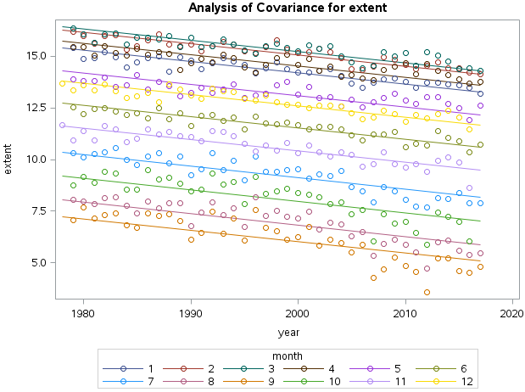
Regression Model:
extent = b1*year + b2*month + b0
Notes:
The disease we focus on is osteoarthritis. The left picture is a healthy human knee joint. The right one is a human knee with osteoarthritis with cartilage degeneration. In contrast, healthy joint has a layer of cartilage. It is white, shining and smooth.

Slide 7
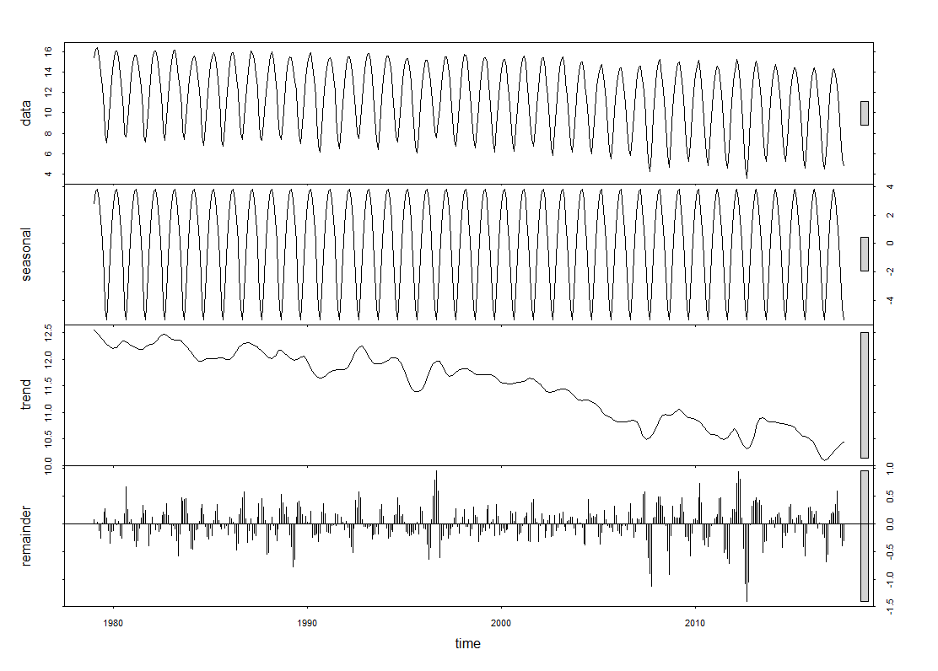
ARIMA Model
Raw data
Seasonality
Drift trend
Residuals
Notes:
The disease we focus on is osteoarthritis. The left picture is a healthy human knee joint. The right one is a human knee with osteoarthritis with cartilage degeneration. In contrast, healthy joint has a layer of cartilage. It is white, shining and smooth.

Slide 8
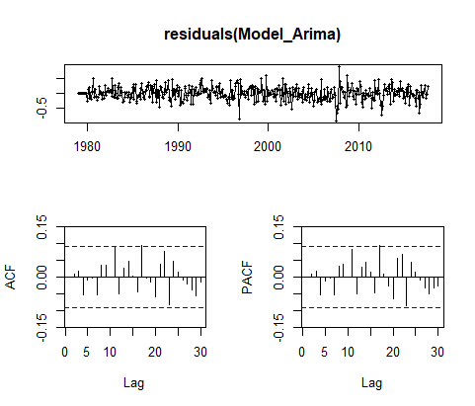
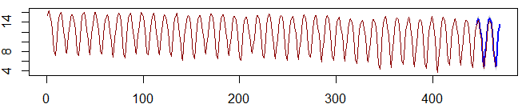
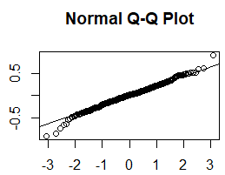
ARIMA(1,0,1)(0,1,1)[12] with drift
Coefficients:
ar1 ma1 sma1 drift
0.5954 0.3337 -0.8114 -0.0045
s.e. 0.0492 0.0586 0.0295 0.0006
AIC=-7.76 AICc=-7.62 BIC=12.82
Prediction for next 20 years
Conclusion : there is evidence of shrinkage of north sea ice over time
Notes:
The disease we focus on is osteoarthritis. The left picture is a healthy human knee joint. The right one is a human knee with osteoarthritis with cartilage degeneration. In contrast, healthy joint has a layer of cartilage. It is white, shining and smooth.

Slide 9
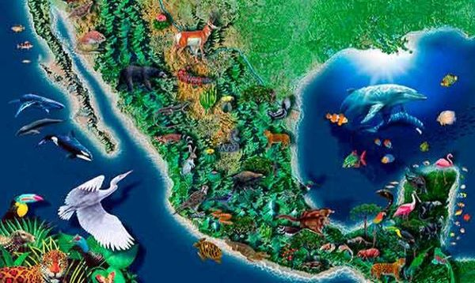
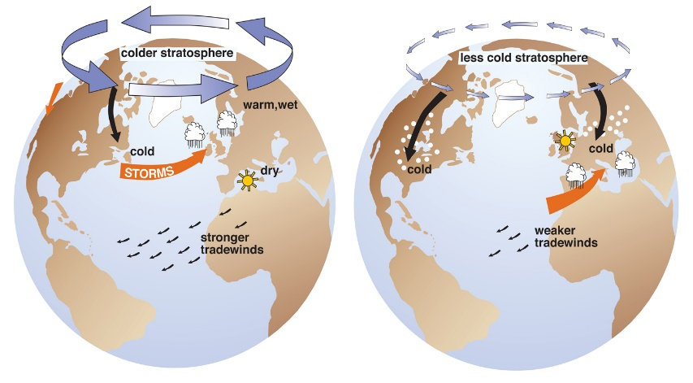
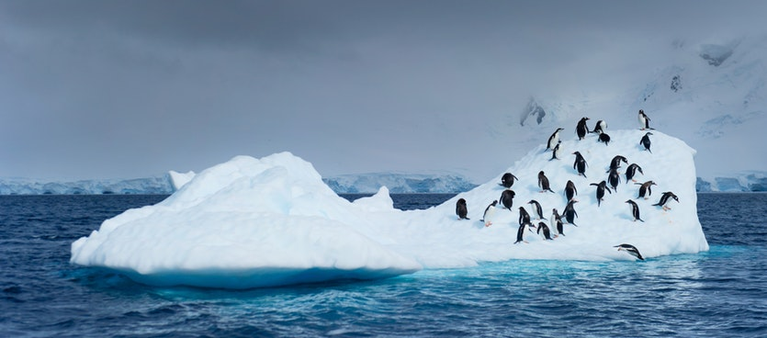
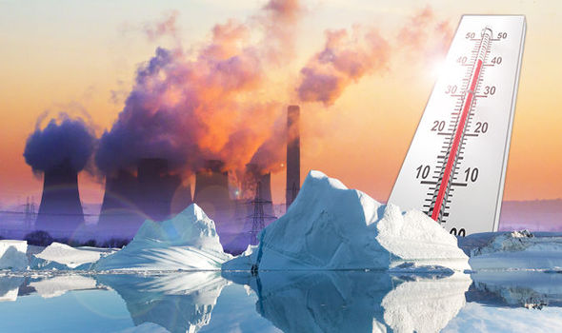
Why is the North Ice Sea Shrinking?
Natural variability
Arctic oscillation cause
the ice transport
Melting the sea ice
Global warming
Notes:
The disease we focus on is osteoarthritis. The left picture is a healthy human knee joint. The right one is a human knee with osteoarthritis with cartilage degeneration. In contrast, healthy joint has a layer of cartilage. It is white, shining and smooth.

Slide 10
Conclusion
Regression and ARIMA are both suitable models to analyze the data set
There is evidence of shrinkage of north sea ice over time based on our analysis of the extend of North Ice sea from 1979 to 2017
Reasons for the shrinkage of north ice sear include: natural variability, sea ice melting, global warming, and arctic oscillation
Notes:
The disease we focus on is osteoarthritis. The left picture is a healthy human knee joint. The right one is a human knee with osteoarthritis with cartilage degeneration. In contrast, healthy joint has a layer of cartilage. It is white, shining and smooth.

Slide 11
Sources
https://earthobservatory.nasa.gov/Features/WorldOfChange/sea_ice.php
paragraph 6
https://earthobservatory.nasa.gov/Features/SeaIce/page3.php
paragraph 9
https://nsidc.org/cryosphere/quickfacts/seaice.html
2nd to last bullet point near the bottom
Notes:
The disease we focus on is osteoarthritis. The left picture is a healthy human knee joint. The right one is a human knee with osteoarthritis with cartilage degeneration. In contrast, healthy joint has a layer of cartilage. It is white, shining and smooth.

Slide 12
Thank you!

